Slide 1
•Constructor and Destructors:
•Definition of constructors & its uses
•Types of constructors: default constructor, parameterized constructor, copy constructor, constructor with dynamic allocation, Dynamic Constructors
•Constructor Overloading
•Destructors

Slide 2
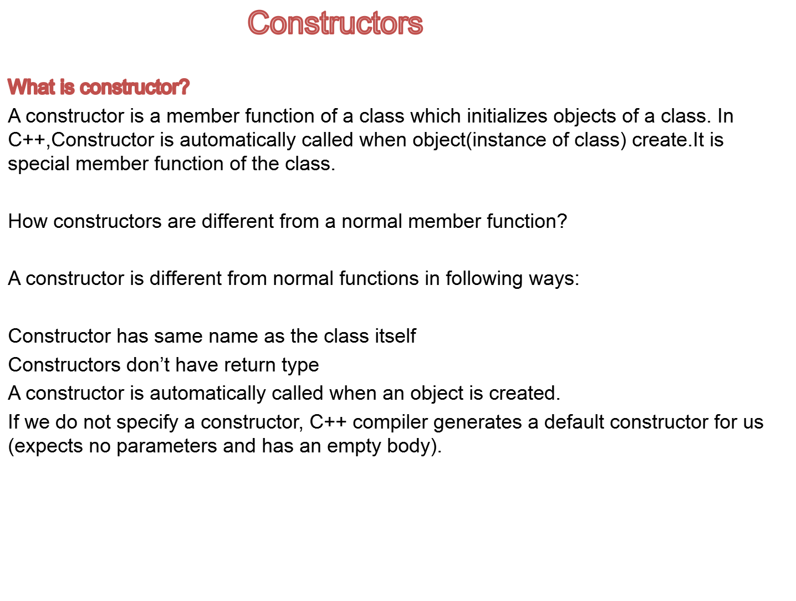

Slide 3
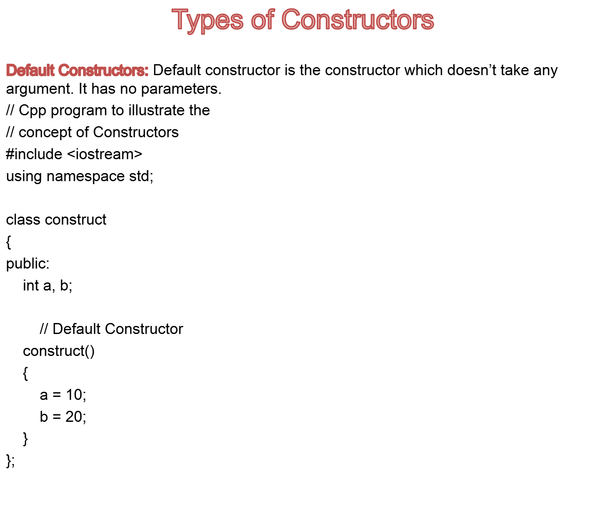

Slide 4
int main()
{
// Default constructor called automatically
// when the object is created
construct c;
cout << "a: "<< c.a << endl << "b: "<< c.b;
return 1;
}
Output:
a: 10
b: 20
Note: Even if we do not define any constructor explicitly, the compiler will automatically provide a default constructor implicitly. The default value of variables is 0 in case of automatic initialization.

Slide 5
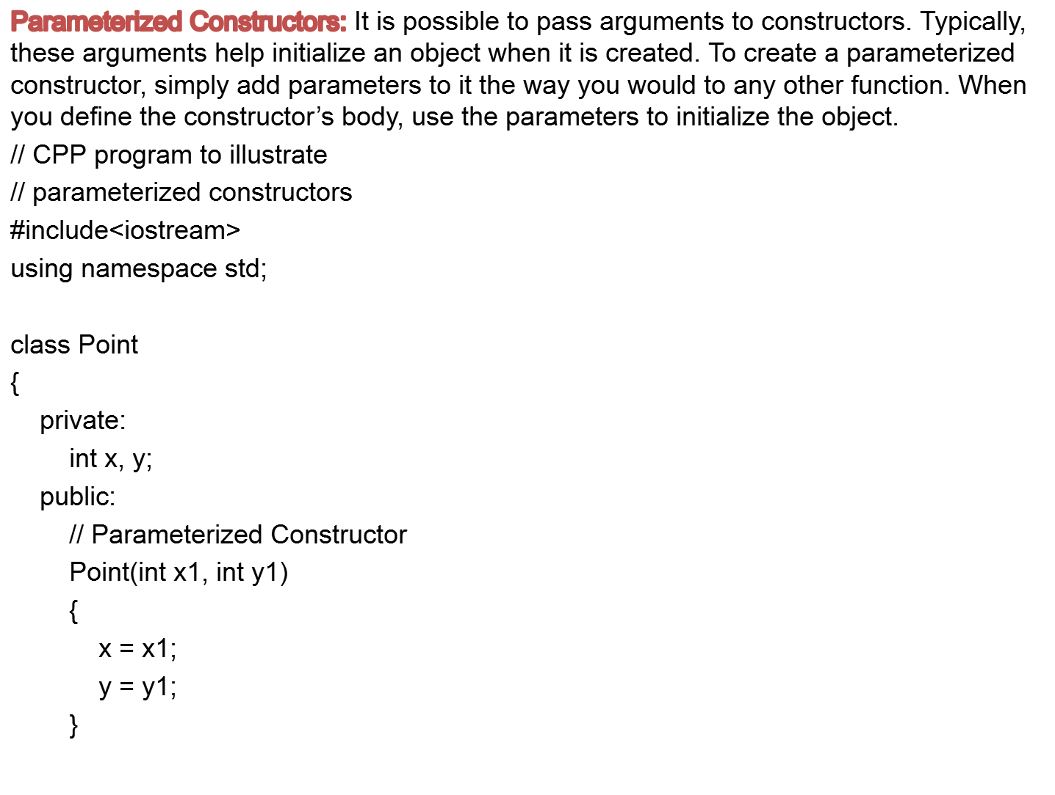

Slide 6
int getX()
{
return x;
}
int getY()
{
return y;
}
};
int main()
{
// Constructor called
Point p1(10, 15);
// Access values assigned by constructor
cout << "p1.x = " << p1.getX() << ", p1.y = " << p1.getY();
return 0;
}
Output:
p1.x = 10, p1.y = 15

Slide 7
When an object is declared in a parameterized constructor, the initial values have to be passed as arguments to the constructor function. The normal way of object declaration may not work. The constructors can be called explicitly or implicitly.
Example e = Example(0, 50); // Explicit call
Example e(0, 50); // Implicit call
Uses of Parameterized constructor:
It is used to initialize the various data elements of different objects with different values when they are created.
It is used to overload constructors.
Can we have more than one constructors in a class?
Yes, It is called Constructor Overloading.

Slide 8
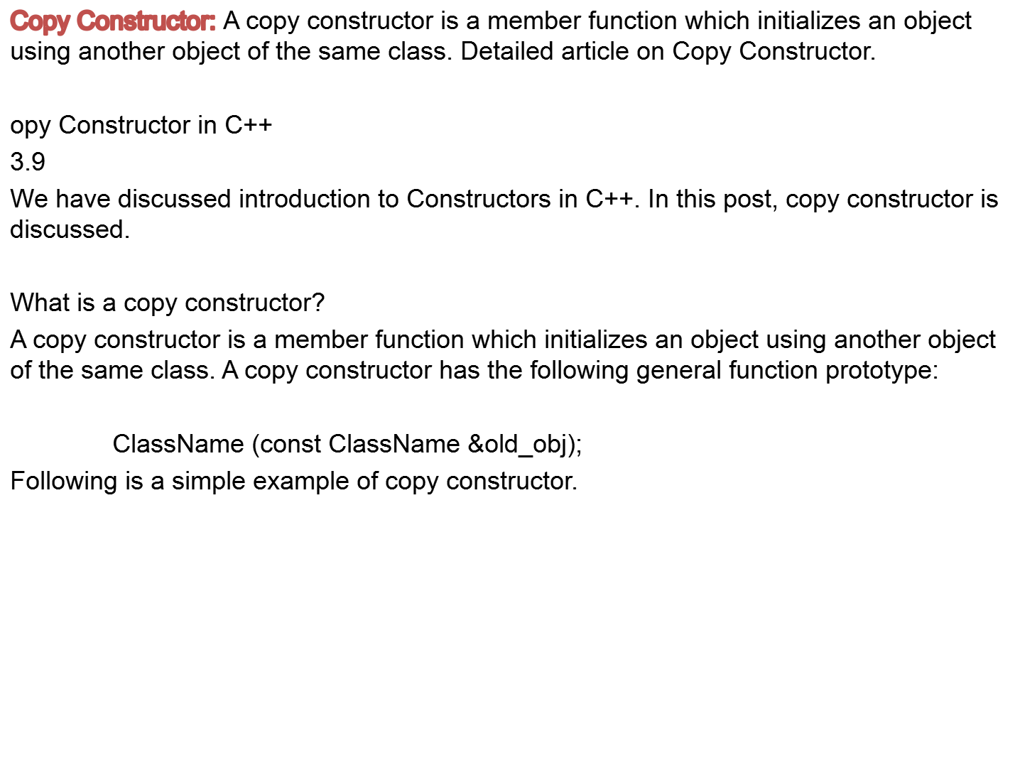

Slide 9
#include<iostream>
using namespace std;
class Point
{
private:
int x, y;
public:
Point(int x1, int y1) { x = x1; y = y1; }
// Copy constructor
Point(const Point &p2) {x = p2.x; y = p2.y; }
int getX() { return x; }
int getY() { return y; }
};

Slide 10
int main()
{
Point p1(10, 15); // Normal constructor is called here
Point p2 = p1; // Copy constructor is called here
// Let us access values assigned by constructors
cout << "p1.x = " << p1.getX() << ", p1.y = " << p1.getY();
cout << "\np2.x = " << p2.getX() << ", p2.y = " << p2.getY();
return 0;
}
Output:
p1.x = 10, p1.y = 15
p2.x = 10, p2.y = 15

Slide 11
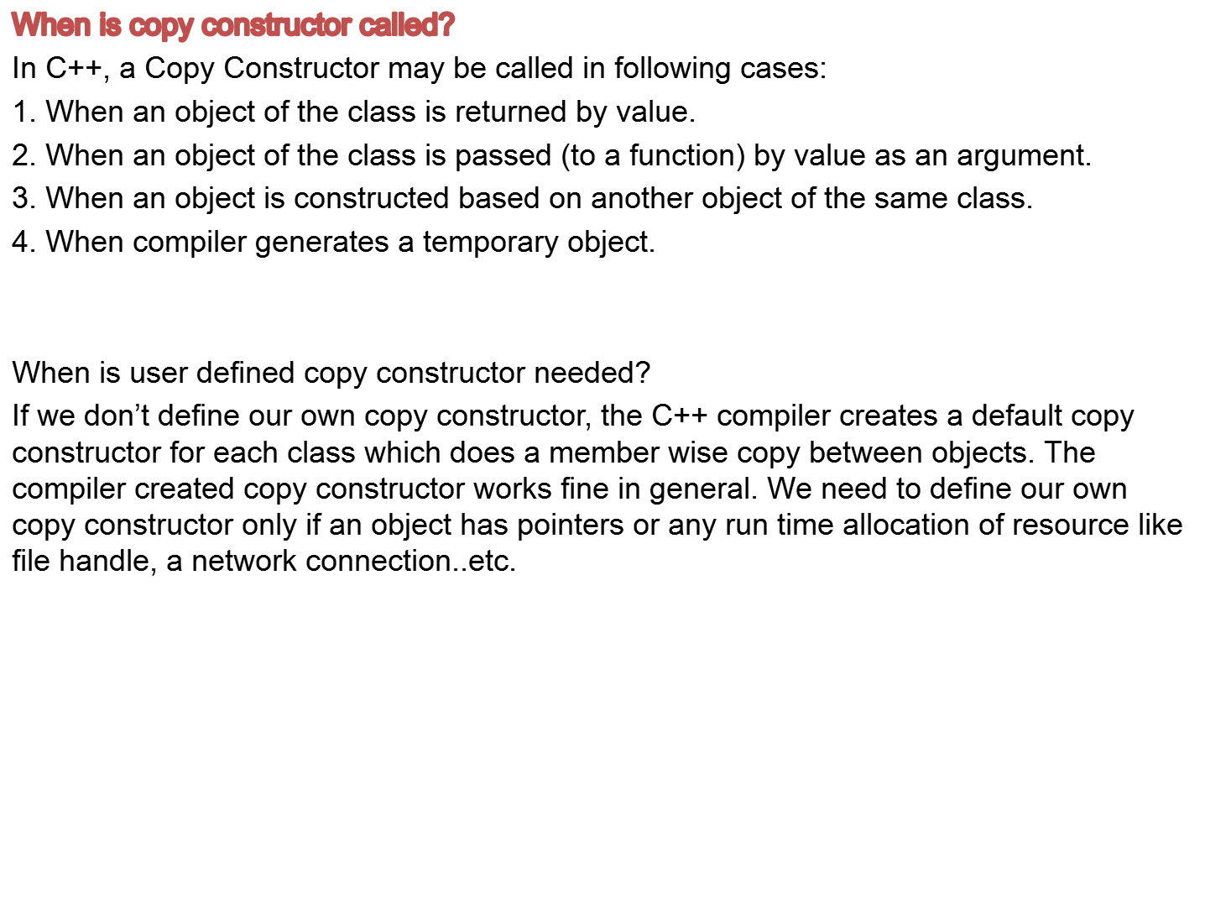

Slide 12
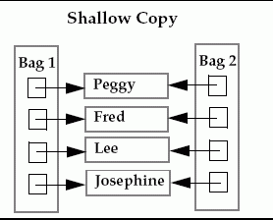
Default constructor does only shallow copy.

Slide 13
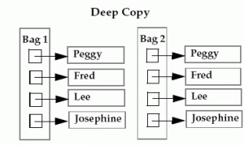
Deep copy is possible only with user defined copy constructor. In user defined copy constructor, we make sure that pointers (or references) of copied object point to new memory locations.

Slide 14
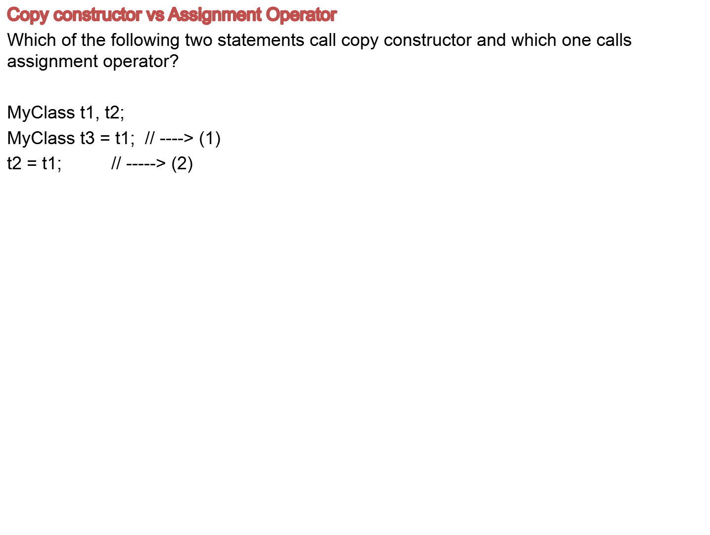

Slide 15
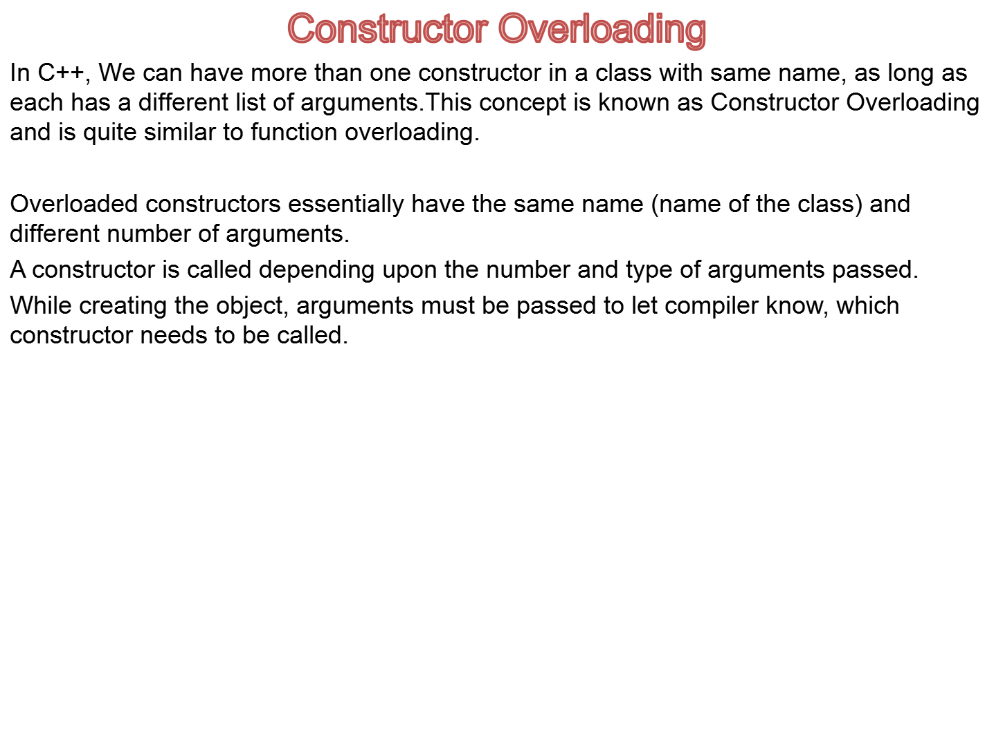

Slide 16
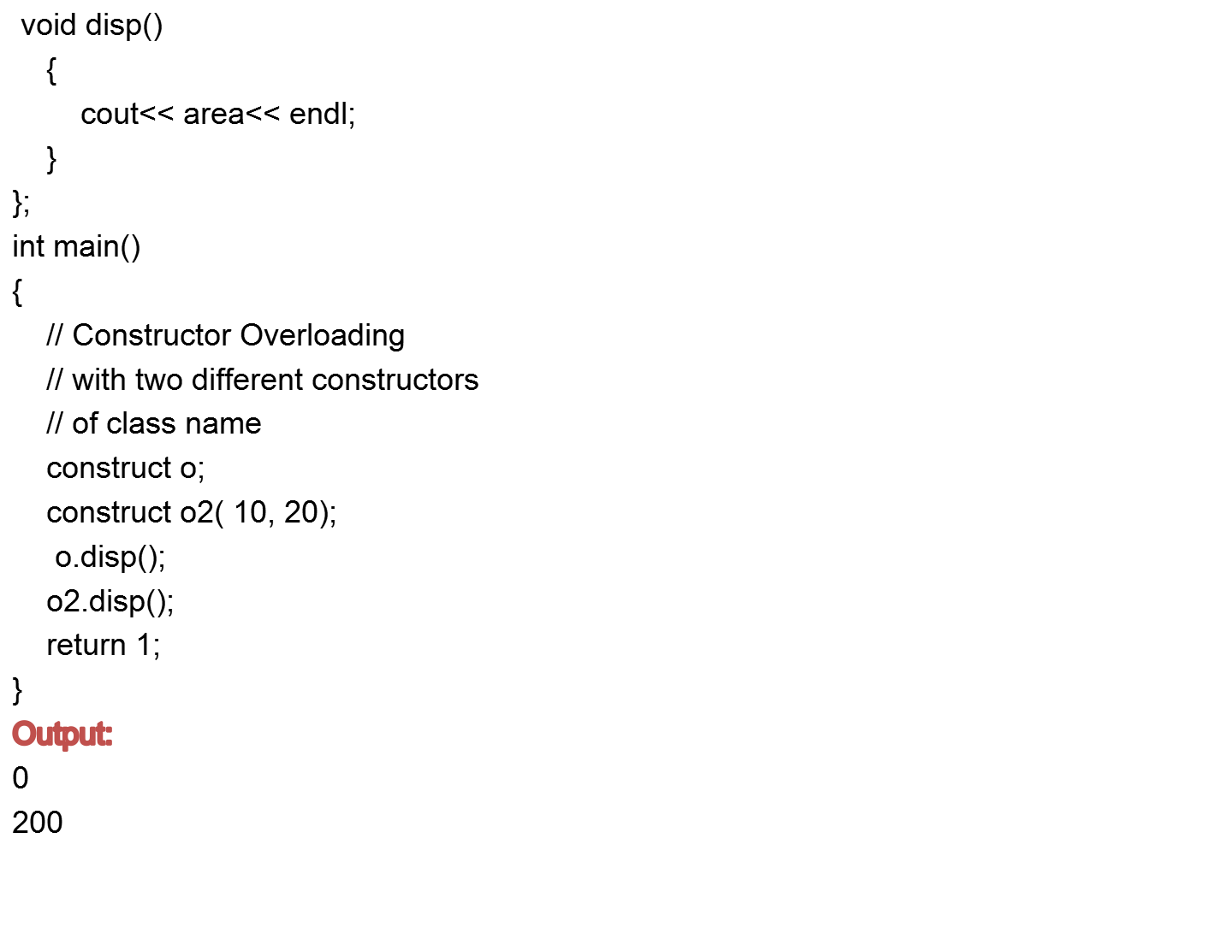

Slide 17
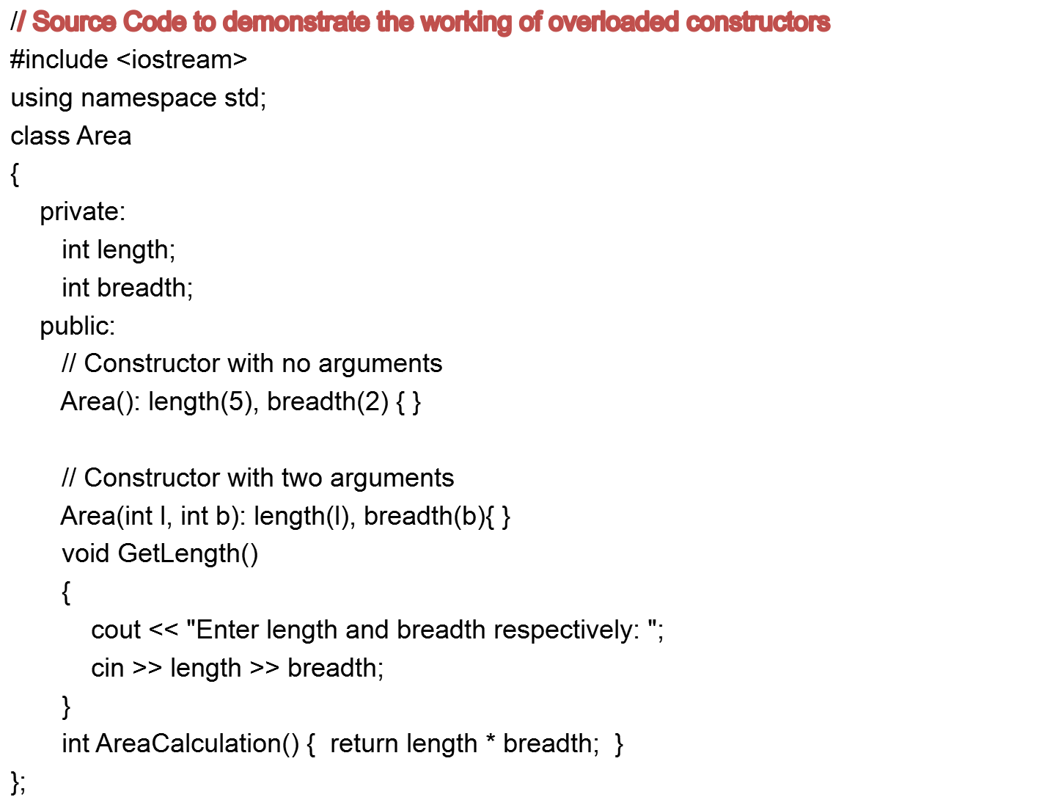

Slide 18
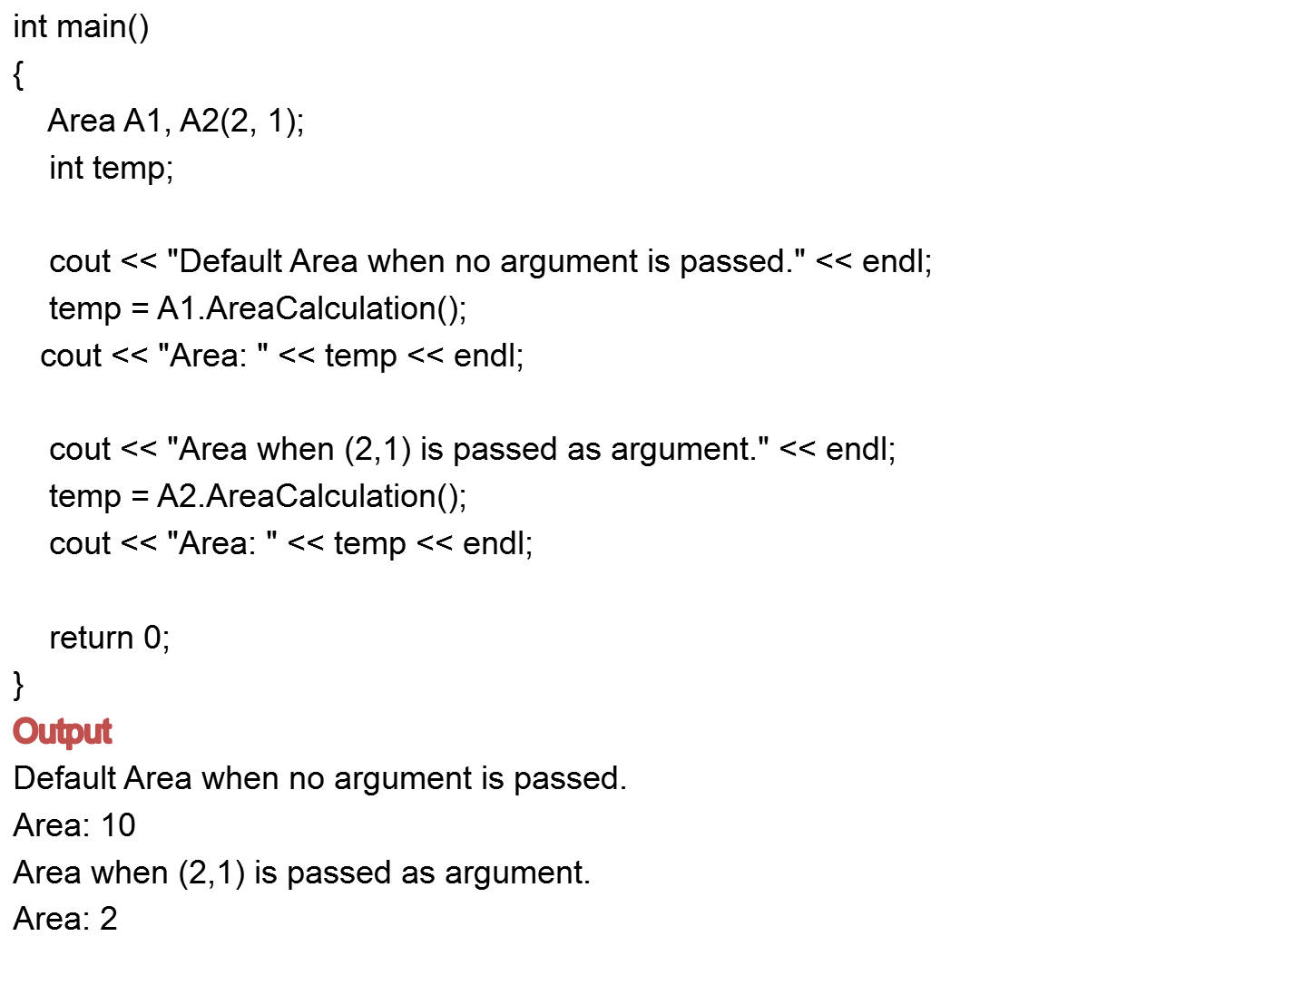

Slide 19
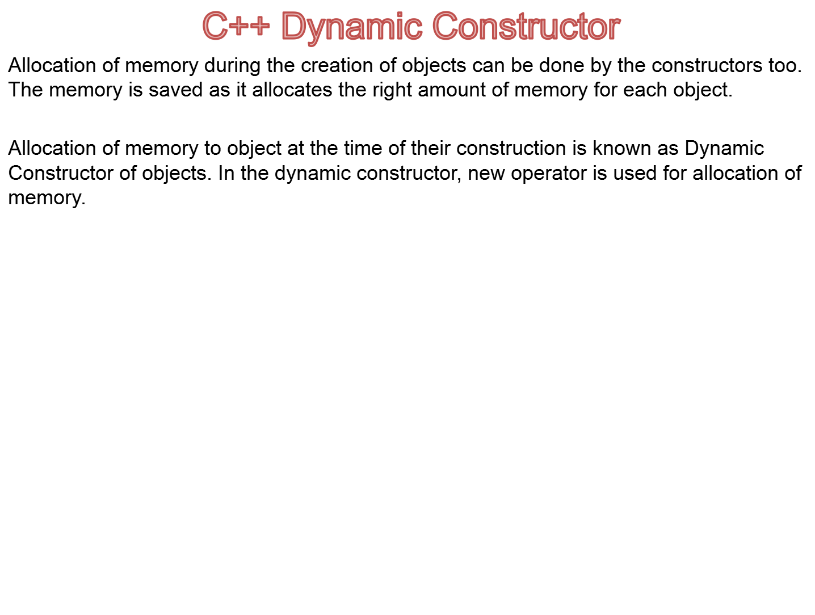

Slide 20
#include<iostream>
#include<string.h>
using namespace std;
class dynamic
{
char *name;
int length;
public :
dynamic()
// First Constructor
{
length = 0;
name = new char[length + 1];
}

Slide 21
dynamic(char *s)
// Second Constructor
{
length = strlen(s);
name = new char[length + 1];
strcpy(name,s);
}
void show()
// Method to display name using dynamic allocation in join method
{
cout << name << "\n";
cout << "Number of characters in the string is " << strlen(name) << "\n\n";
}
void join(dynamic &a, dynamic &b)
{
length = a.length + b.length;
delete name;
name = new char[length + 1];
// dynamic allocation of name using new
strcpy(name, a.name);
strcat(name, b.name); } };

Slide 22
int main ()
{
char *first = "Hello !";
dynamic name1(first);
dynamic name2("Technology");
dynamic name3("Lovers");
dynamic s1, s2;
s1.join(name1, name2);
s2.join(s1, name3);
name1.show();
name2.show();
name3.show();
return 0;
}

Slide 23
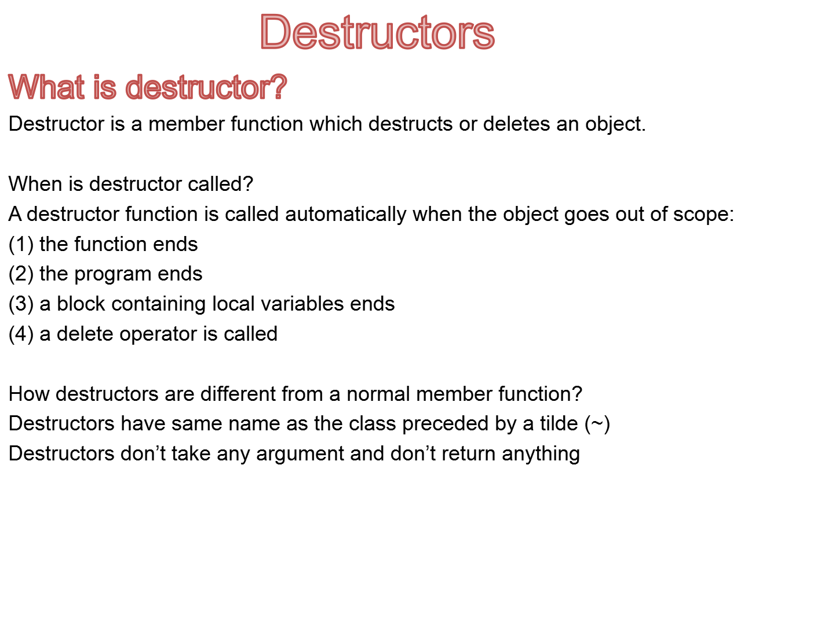

Slide 24
class String
{
private:
char *s;
int size;
public:
String(char *); // constructor
~String(); // destructor
};
String::String(char *c)
{
size = strlen(c);
s = new char[size+1];
strcpy(s,c);
}
String::~String()
{
delete []s;
}

Slide 25
